Slide 1
Communicative skills
Group 19
Formal Letters

Slide 2
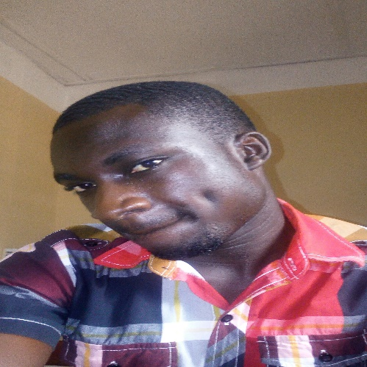

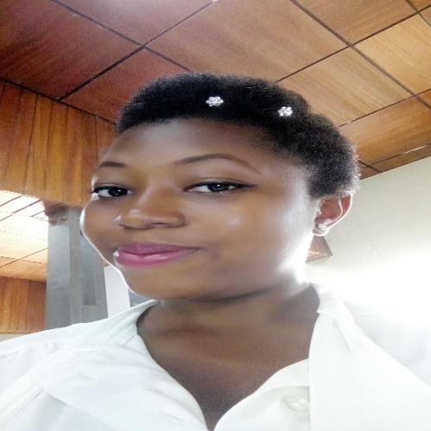
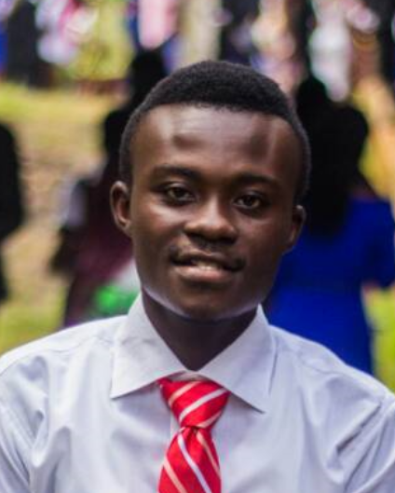

Group members
GYEDU MOSES
SS|TMG|17|0010
AUSTIN SAGOE ELISHA
PS|ITC|17|0021
ADOBOE LINDA
PS|MEC|17|0006
ASARE KYEI DANIEL
PS|ITC|17|0003

Slide 3
Objectives
At the end of the presentation, one should be able to Identify:
Formal Letters
Types of formal Letters
Features of Formal Letters
Uses of Formal Letters
Languages of Formal Letters

Slide 4
Introduction
A letter is one person's written message to another pertaining to some matter of common concern. Letters can serve several purposes: when intimates are forced to spend time at great distances from one another, letters allow them to maintain the relationship; rulers, scholars, merchants, officials, and professionals use them to conduct affairs with their far-flung correspondents; poets and other writers may also use them as vehicles for self-expression. Letters contribute to the protection and conservation of literacy.
There are three main types of letters and they include;
Informal letters
Semi-formal letters
Formal letters
But we will lay more emphasis on the formal letters.

Slide 5
Formal Letters
Formal letters are one of the most common form of official letters, framed and presented in almost all organizations, be it companies, schools, colleges, business firms, institutions, agencies, or any departments of corporate sectors. Formal letter writing is undoubtedly one of the most challenging types of letter format. When putting it together, often you are addressing a person or organization with whom you are not familiar and the quality of your content, including spelling and grammar will be strongly scrutinized. In general, what you put together will have one of the following purposes:
Make a complaint
Request something
Make an enquiry

Slide 6
Types of Formal letters
Letter of rejection.
Resignation letter.
Letter of recommendation.
covering letter.
Thank you letter.
Letter of introduction.
Letter of interest.

Slide 7
Features of Formal Letter
Address
Date
Salutation
Title/Heading
Body
Subscription

Slide 8
Features of Formal Letter
Addresses:
An address is one of the compulsory components of a letter. Regardless of what type of letter you are writing, you simply cannot write a letter without putting an address. A formal or an official letter will require that the writer supply two addresses that is;
Writer’s Address
The return address should be written in the top right-hand corner of the letter. That indicates the address of the person writing the letter.
Recipient Address
The inside address should be written on the left, starting below your date. It mostly indicates the address of the receiver.

Slide 9
Features of Formal Letter
Styles of Addresses for A Letter
Slant Method Address
The slant method of writing an address is very similar to an upturned triangle or pyramid. Here, the address is written in such a manner that it resembles an upside down pyramid or triangle; when the date of the address is added to it then it begins to look more like an hourglass.
Example of a slanted address is:
Obuatupam Nkatenkwam Primary School,
P.O. Box 223,
Kumasi.
The Block/Straight line Method Address
This type of address can be used when writing both a formal and informal letter. The block address is a type of address where the writer writes the beginning of each of a line of the address in such a manner that they form a straight line.
Example of the block/straight address:
Obuatupam Nkatenkwam Primary School,
P.O. Box 223,
Kumasi.

Slide 10
Features of Formal Letter
Date: Different people put the date on different sides of the page. You can write this on the right just below the writer's address to.
For example;
January 25th, 2018
25th January, 2018
25-01-2018
25/01/2018

Slide 11
Features of Formal Letter
Salutation or greeting: Salutations are your greetings meant for the recipient of the letter. They are always formal.
For example;
Dear Sir or Madam,
If you do not know the name of the person you are writing to, use this. It is always advisable to try to find out a name.
Dear Mr. Jenkins,
If you know the name, use the title (Mr., Mrs., Miss or Ms., Dr, etc.) and the surname only. If you are writing to a woman and do not know if she uses Mrs. or Miss, you can use Ms., which is for married and single women.

Slide 12
Features of Formal Letter
Heading/Title
This carries the reason you are writing the letter in one sentence, it should be in capital letters and should be underlined. It is the subject of the formal letter that is; it carries the main idea for writing the letter.
For example:
APPLICATION FOR EMPLOYMENT
PROBLEMS FACING MY COMMUNITY
Reasons Why Students Attend Lectures Late.

Slide 13
Features of Formal Letter Cont.
Body
The body, contains paragraph that merge to elaborate on the heading sated above in your letter. It has three main parts which are;
First /introductory Paragraph: The first paragraph of formal letters should include an introduction to the purpose of the letter. It's common to first thank someone or to introduce yourself and show the motive behind the letter.
Main Paragraphs: Normally, the following paragraphs should provide the main information of the letter, and build on the main purpose in the introductory or first paragraph. Mostly formal letter has main ranging between 2-5 paragraphs.
Final/concluding Paragraph: The final paragraph should shortly summarize the intent of the formal letter and end with some call to action.
Note: “Thank you” is part of the concluding paragraph but, is written on the next line of the concluding paragraph.

Slide 14
Features of Formal Letter
Subscription
  Yours faithfully;
  If you do not know the name of the person, end the letter this way.
  Yours sincerely;
  If you know the name of the person, end the letter this way.
Your signature and Name:
Sign your name, then print it underneath the signature. If you think the person you are writing to might not know whether you are male or female, put you title in brackets after your name.

Slide 15
Uses of formal letters
Communication: Formal Letters are written to communicate an information, a request and recommendation to an official reader.
How serious a letter is, it is used to show how serious the piece of writing is and the need for it to read and taking the information into consideration.
To write to high ranking people; It most often written to Managers, CEOs, Governmental and Non-Governmental Organizations and institutions
When writing from one organization to the other.

Slide 16
Languages Of Formal Letters
Use proper spelling: Use correct spelling all of the time. This includes avoiding short forms and only using words that are found in the dictionary. This means that you must write "tonight" instead of "2nite" and "because" instead of "bc.“
Use proper punctuation: Question marks and to the ellipsis (which should have only three dots). In addition, you should also void the ampersand (&); write out the word "and.“
Use full words: Contractions are appropriate only for conversational use and for informal writing, never for technical or formal writing. Note that the full form of “can't" is one word: "cannot" not "can not". You should also avoid using abbreviated words such as "TV" and "photo" and use the full versions such as "television" and "photograph".
Do not write as you would speak: So, like, you know, I totally don't even do that OMG! To ensure you are maintaining a formal tone, you need to leave out words and phrases that are not essential to conveying your point. For example, avoid using "well," "like," "for sure," "you know," and similar phrases.

Slide 17
Cont. of Languages of Formal Letters
Emoticons should never be used: First of all, it is never acceptable to use emoticons, including smiley faces, sad faces, winks, etc. suggest finding another way to tell your boss you are very happy about your raise or you may be finding another job!
Avoid using first and second person pronouns: Formal writing often tries to be objective, and the pronouns "I" and "you" tend to imply subjectivity. Instead, use words such as "one," "one's," "the reader," the "author's," etc. For example:
Informal: "You should sleep eight hours each night."
Formal: "One should sleep eight hours each night.”
Use transitional adverbs such as:
"additionally" or "moreover"
"nevertheless" or "however"
"therefore" or "thus"
"alternatively" or "instead" or "otherwise"

Slide 18
THANK YOU

